Slide 10
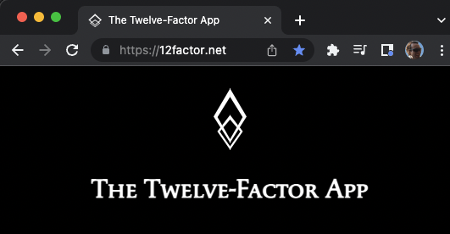
The twelve-factor app

Slide 11
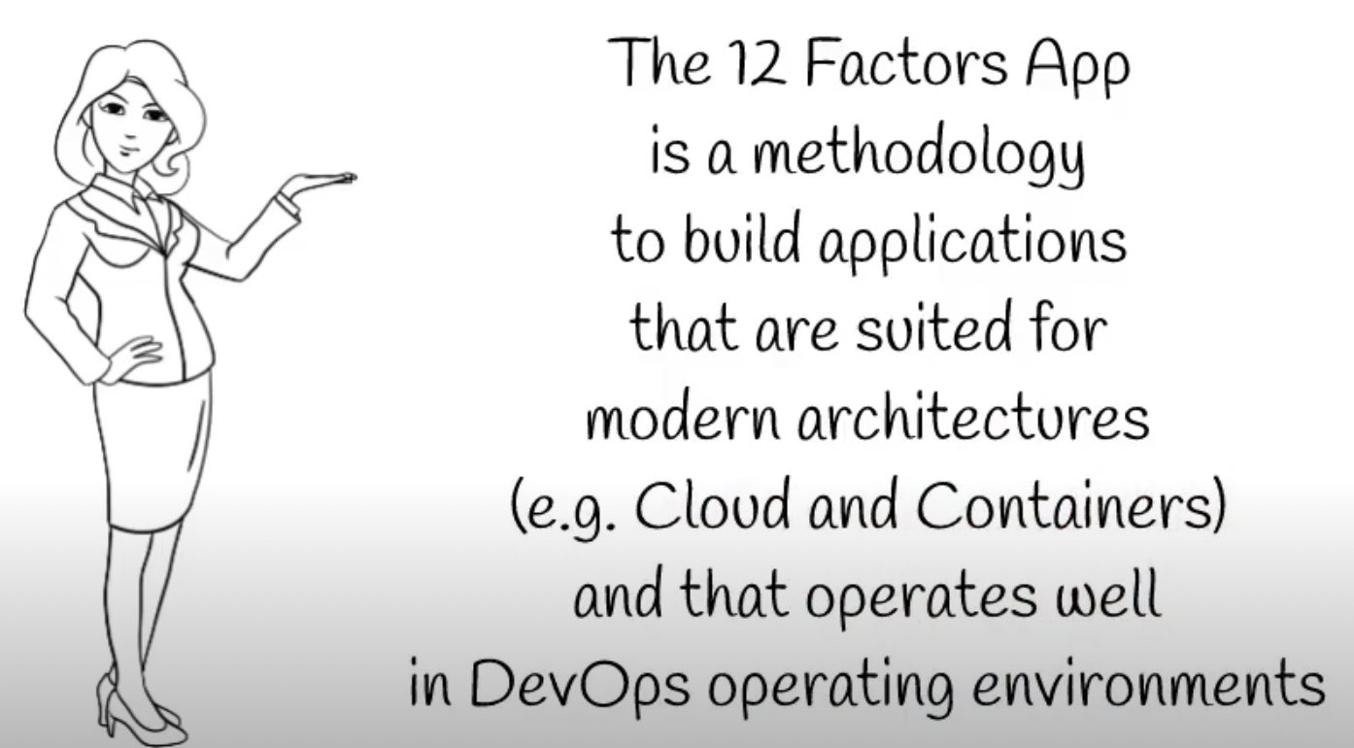
what

Slide 12
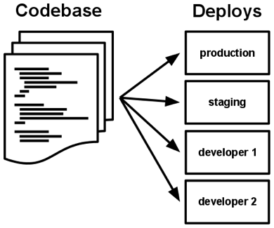
I. Codebase
One codebase tracked in revision control, many deploys
A codebase is any single repo or any set of repos who share a root commit

Slide 13




II. Dependencies
Explicitly declare and isolate dependencies
A twelve-factor app never relies on implicit existence of system-wide packages

Slide 14
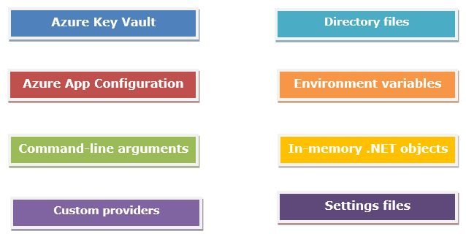
III. Config
Store config in the environment
strict separation of config from code

Slide 15
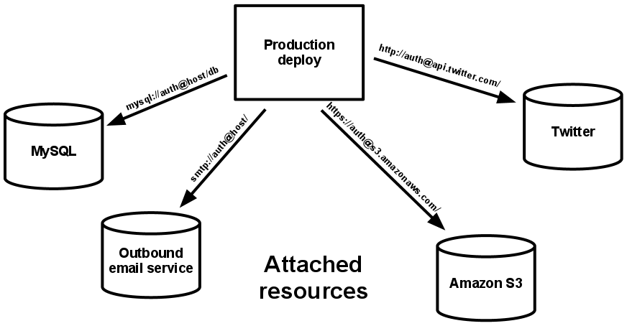
IV. Backing services
Treat backing services as attached resources
The code for a twelve-factor app makes no distinction between local and third party services

Slide 16
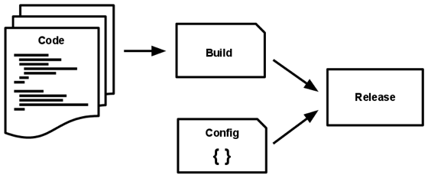
V. Build, release, run
Strictly separate build and run stages
The twelve-factor app uses strict separation between the build, release, and run stages

Slide 17
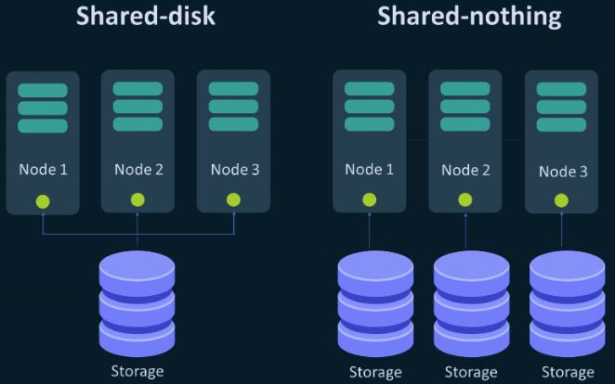
VI. Processes
Execute the app as one or more stateless processes
Twelve-factor processes are stateless and share-nothing

Slide 18
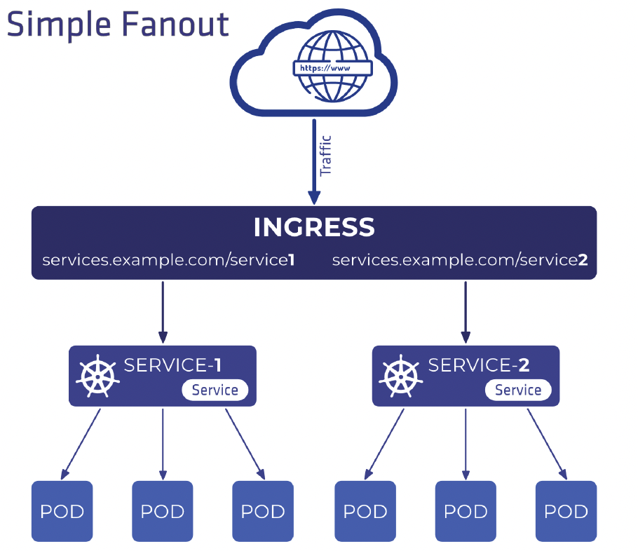
VII. Port binding
Export services via port binding
The twelve-factor app is completely self-contained

Slide 19
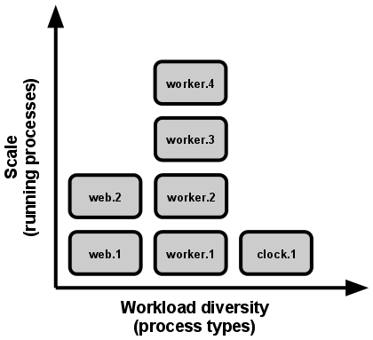
VIII. Concurrency
Scale out via the process model
In the twelve-factor app, processes are a first class citizen: the unix process model for running service daemons.

Slide 20
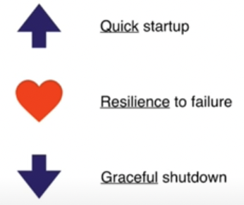
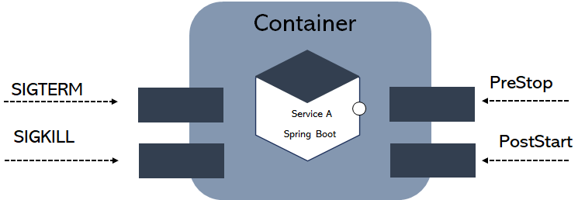
IX. Disposability
Maximize robustness with fast startup and graceful shutdown
The twelve-factor app’s processes are disposable, meaning they can be started or stopped at a moment’s notice

Slide 21
X. Dev/prod parity
Keep development, staging, and production as similar as possible
 | Traditional app | Twelve-factor app
Time between deploys | Weeks | Hours
Code authors vs code deployers | Different people | Same people
Dev vs production environments | Divergent | As similar as possible
The twelve-factor developer resists the urge to use different backing services between development and production,

Slide 22
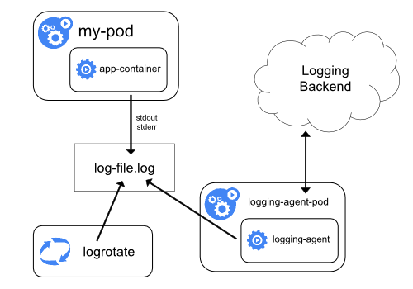
XI. Logs
Treat logs as event streams
https://kubernetes.io/docs/concepts/cluster-administration/logging/
A twelve-factor app never concerns itself with routing or storage of its output stream

Slide 23
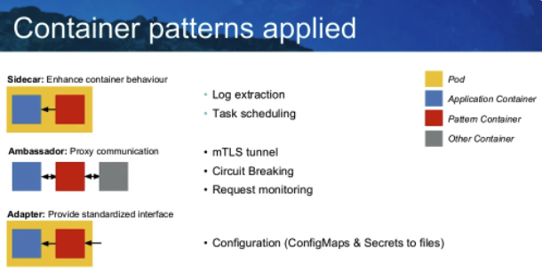
XII. Admin processes
Run admin/management tasks as one-off processes
Running database migrations, console, one-time scripts

Slide 24
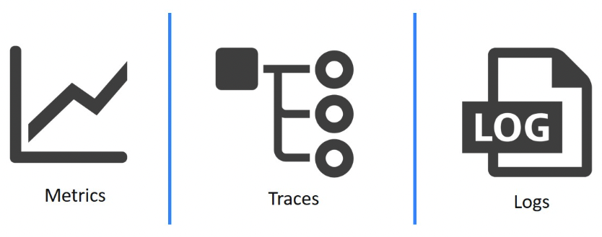
XII. Observability
Internal states of a system can be inferred from knowledge of its external outputs

Slide 25

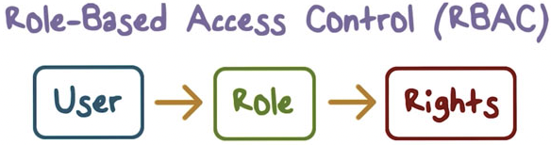

XIV. security
Modern apps should take security-first

Slide 26
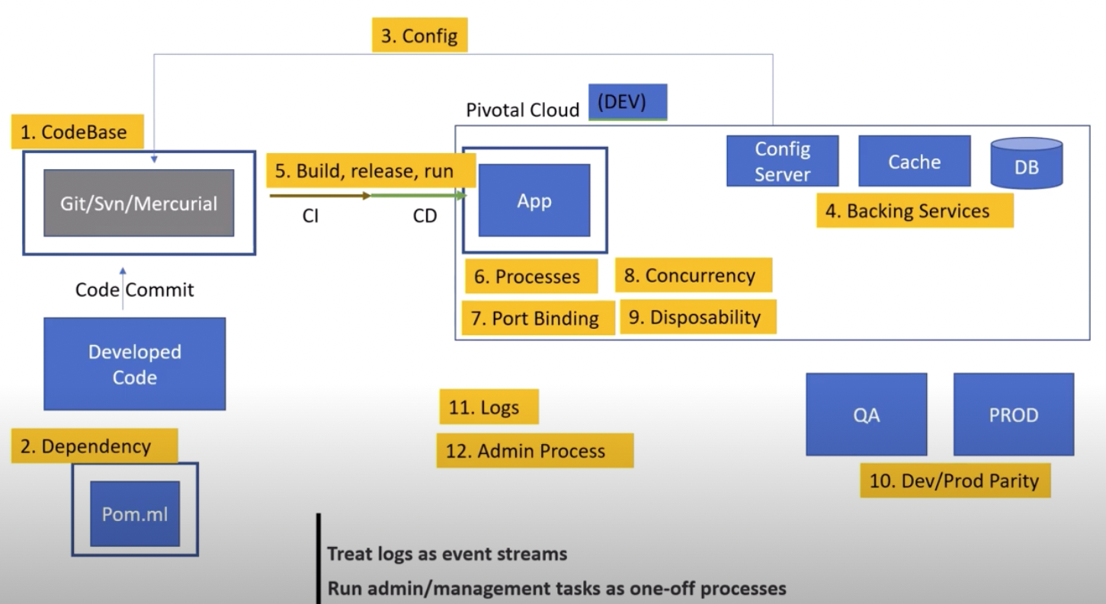
The global view

Slide 27
references
The twelve-factor app
12 Factor App - #6MinuteSaturdays #1 | Tech Primers
12 Factors App | MicroServices Architecture | Cloud Native Best Practices
Introduction to 12 Factor App
5 Years of 12 Factor Apps by Joe Kutner

